Slide 1
3-D Detection and Jewelry
Sprint 2
A1_Group #3 on0007@bu.edu
Orif Negmatov

Slide 2


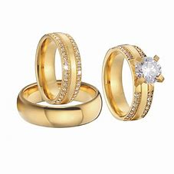
1A. Product mission
For the jewelry item customers, who need a verification process to make sure the product they purchase is authentic.

Slide 3

1B. Users
Couples
Brides/ Married people

Slide 4
2. Literature Review
ARkit tool is available, developed by Apple. Inc
Tool for app developers
Examples of ARKit applications:
3D view of Ikea products
Interior decoration project
Machine learning tools might be useful
Xcode
API documentation
Apple Forums
Optical Spectroscopy
Notes:
What is ARKit? ARkit stands for Augmented Reality Kit, a development platform that enables app developers to build AR experiences quickly and easily into their apps and games. It utilizes your iOS device's camera, processors, and motion sensors to create some immersive interactions. For example, one could preview Ikea products in his or her own home before making a purchase and look at the product from all the angles needed. With the aid of AR, it is even possible to measure the Ikea furniture dimensions and test the product virtually whether a chair or couch fits in the living room or a bed fits in the bedroom.
In the second example, which is Interior decoration project, multiple users with different devices are able to see the same AR environment. All users can contribute to the Interior decoration project from their own devices.
Spectroscopy is used as a tool for studying the structures of atoms and molecules. The large number of wavelengths emitted by these systems makes it possible to investigate their structures in detail, including the electron configurations of ground and various excited states.

Slide 5
3A. User Stories
“I, the customer, want to know what is my ring made of.”
“I, jewelry shop retail worker, would like to know the properties of the ring or necklace items, so I can explain that to the customer”
“I, business manager, want to make sure that my jewelry items are of high quality and there is no counterfeit items on my sale list”
“I, the customer, would like to compare the properties of one item to another and make a thoughtful decision which one to purchase for my wedding”

Slide 6
3B. Minimum Value Product (MVP)
Mobile application that scans and recognizes jewelry items
The app receives an image as Input
And will speak out the properties of the item

Slide 7
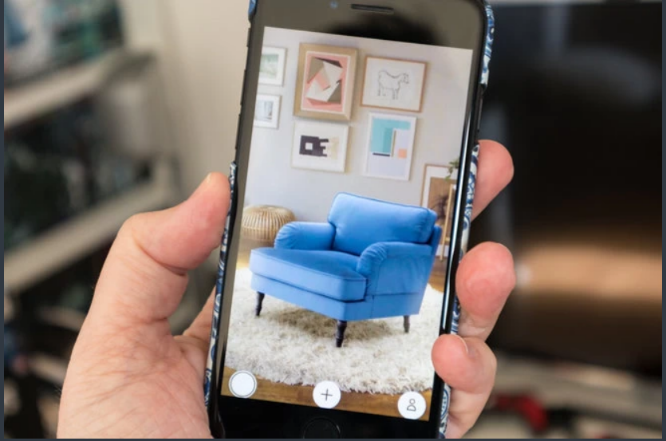
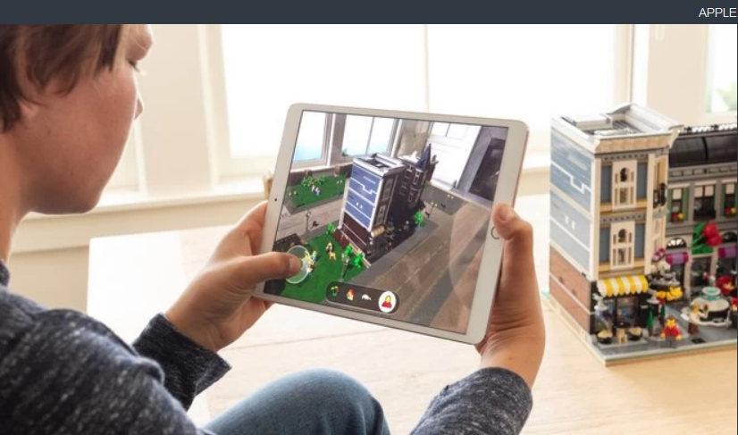
3C. Similar Products available
Examples of ARKit applications:
3D view of Ikea products
Interior decoration project
Room for creativity
ARkit - amazing tool for mobile app developers

Slide 8
4. Our Technology
The mobile app scans the jewelry item
It responds back to the customer about the details of the item
and tells a brief history of the item, who made it, where, etc.
Compares the item with other items in the market
Figures out the authenticity of the item
by using pattern recognition
machine learning method is required

Slide 9
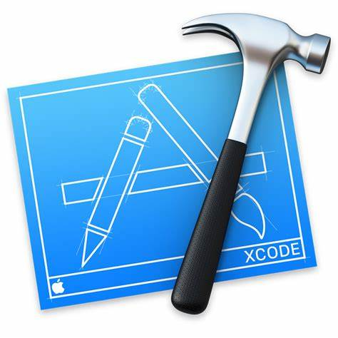


4. Technologies
Xcode
Google Drive
Github

Slide 10
5. Sprint 3 Goals
Get started with ARkit
Look at Apple’s developer website
Run sample codes from Github

Slide 11
6. Obstacles
Can’t run Xcode in Windows
Need MacOS machine
SCC in BU doesn’t provide access to Xcode or Swift applications

Slide 12
7.Next Sprint Goals
Get familiar with Xcode and Swift
Run the sample codes available online
Test and use Lidar sensor on Iphone
Getting app to function on basic items, not necessarily for jewelry first
Start building the MVP model so that it scans the item at least

Slide 13
6. References
https://www.researchgate.net/profile/Marek-Woda/publication/333039077_Capabilities_of_ARCore_and_ARKit_Platforms_for_ARVR_Applications/links/5d24e096299bf1547ca75dfe/Capabilities-of-ARCore-and-ARKit-Platforms-for-AR-VR-Applications.pdf?origin=publication_detail
https://www.researchgate.net/profile/Marek-Woda/publication/333039077_Capabilities_of_ARCore_and_ARKit_Platforms_for_ARVR_Applications/links/5d24e096299bf1547ca75dfe/Capabilities-of-ARCore-and-ARKit-Platforms-for-AR-VR-Applications.pdf?origin=publication_detail
Singh, R.D., Mittal, A. & Bhatia, R.K. 3D convolutional neural network for object recognition: a review. Multimed Tools Appl 78, 15951–15995 (2019). https://doi.org/10.1007/s11042-018-6912-6
https://www.sciencedirect.com/science/article/abs/pii/S0925963503002620

Slide 14
Thanks for listening

